Slide 1




GridWorld
© A+ Computer Science - www.apluscompsci.com

Slide 2
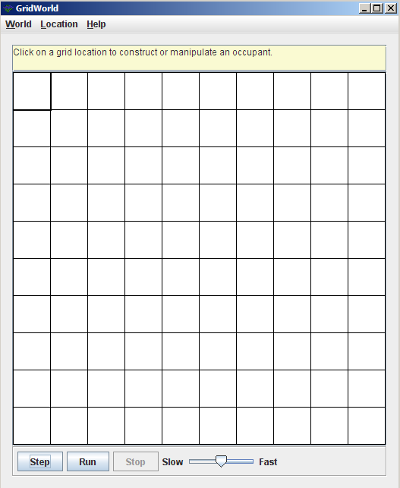
What is GridWorld?
Row = 0
Column = 0
© A+ Computer Science - www.apluscompsci.com
Notes:
A grid is a structure that has rows and columns.
A spreadsheet is a grid.
A checker board is a grid.

Slide 3
What is GridWorld?
cols
rows
A grid is a structure that has rows and columns.
© A+ Computer Science - www.apluscompsci.com
Notes:
A grid is a structure that has rows and columns.
A spreadsheet is a grid.
A checker board is a grid.

Slide 4
What is GridWorld?
Row = 2
Column = 1
© A+ Computer Science - www.apluscompsci.com
Notes:
A grid is a structure that has rows and columns.
A spreadsheet is a grid.
A checker board is a grid.

Slide 5
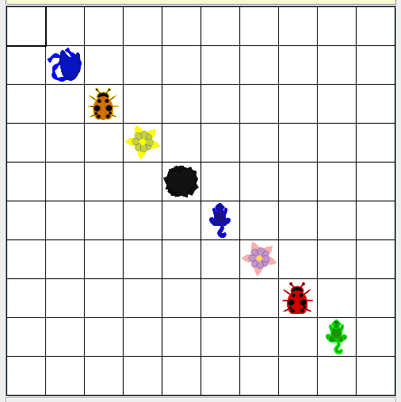
What is GridWorld?
© A+ Computer Science - www.apluscompsci.com

Slide 6
GridWorld
Classes
© A+ Computer Science - www.apluscompsci.com

Slide 7
ActorWorld
© A+ Computer Science - www.apluscompsci.com

Slide 8
ActorWorld frequently used methods
Name | Use
ActorWorld() | creates a new world using 10X10 grid
ActorWorld(grid) | creates a new world using grid
add(loc, thang) | add thang at spot loc
add(thang) | add thang at a random empty loc
show() | makes the world visible
import info.gridworld.actor.World;
© A+ Computer Science - www.apluscompsci.com

Slide 9
ActorWorld
ActorWorld earth = new ActorWorld();
earth.show();
© A+ Computer Science - www.apluscompsci.com
Notes:
ActorWorld is used to graphically display a grid of Actors.

Slide 10
ActorWorld
A reference variable stores the
memory address of an object.
ActorWorld earth = new ActorWorld();
© A+ Computer Science - www.apluscompsci.com
Notes:
A reference variable is used to store the location of an Object. In most situations, a reference stores the actual memory address of an Object.
earth stores the location / memory address of a new ActorWorld object.

Slide 11
ActorWorld
ActorWorld earth = new ActorWorld();
earth
0xF5
0xF5
ActorWorld Object
earth stores the address of an ActorWorld
© A+ Computer Science - www.apluscompsci.com
Notes:
A reference variable is used to store the location of an Object. In most situations, a reference stores the actual memory address of an Object.
earth stores the location / memory address of a new ActorWorld.

Slide 12

ActorWorld
reference
command / method
earth.show();
© A+ Computer Science - www.apluscompsci.com
Notes:
earth is a reference to an ActorWorld.
earth.show() calls the ActorWorld show method to show the grid of actors graphically.

Slide 13
open
gridworldone.java
© A+ Computer Science - www.apluscompsci.com

Slide 14
Location
© A+ Computer Science - www.apluscompsci.com

Slide 15
Location frequently used methods
Name | Use
Location(row, col) | creates a new row,col Location
getCol() | gets the column value for this location
getRow() | gets the row value for this location
import info.gridworld.grid.Location;
© A+ Computer Science - www.apluscompsci.com
Notes:
Location is a class that stores row and column information.
Location spot = new Location(4,5);
spot has a row value of 4 and a column value of 5.

Slide 16
Location
Location locTwo = new Location(3,5);
System.out.println(locTwo);
Location locThree = new Location(2,9);
System.out.println(locThree);
OUTPUT
(3, 5)
(2, 9)
The Location class stores row and column information.
© A+ Computer Science - www.apluscompsci.com
Notes:
Location is a class that stores row and column information.
Location spot = new Location(4,5);
spot has a row value of 4 and a column value of 5.

Slide 17
Location
reference variable
Location theLoc = new Location(3,4);
object instantiation
© A+ Computer Science - www.apluscompsci.com
Notes:
Location is a class which must be instantiated before it can be used. In other words, you must make a new Location if you want to use a Location. A reference must be used to store the location in memory of the Location object created.
A row value and a column value must be passed as parameters to the Location constructor.
theLoc is a reference that will store the location/memory address of newly created Location object.

Slide 18
open
locationone.java
© A+ Computer Science - www.apluscompsci.com

Slide 19
Actor
© A+ Computer Science - www.apluscompsci.com

Slide 20

Actor
Actor is the basic object from which all other GridWorld actors will be built.
Each of the new actors created will extend the original actor class.
© A+ Computer Science - www.apluscompsci.com

Slide 21
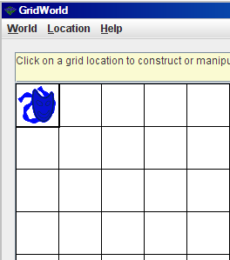
Actor
ActorWorld world = new ActorWorld();
Actor dude = new Actor();
Location loc = new Location(0,0);
world.add(loc, dude);
world.show();
What happens if you click
on the actor?
© A+ Computer Science - www.apluscompsci.com
Notes:
The add method of class World receives a Location parameter and an Actor reference.
The Actor reference is stored in the grid at the specified Location.
The default color of an Actor is BLUE.
ActorWorld world = new ActorWorld();
Actor dude = new Actor();
Location loc = new Location(0,0);
world.add(loc, dude);
world.show();

Slide 22
Methods
reference
command / method
world.add(loc, dude);
Methods are used to tell an object what to do.
© A+ Computer Science - www.apluscompsci.com
Notes:
World is the reference to an world.
Add is a method that adds a reference at a particular location.
The add method is called to tell world to add dude at location loc.

Slide 23
open
actorone.java
© A+ Computer Science - www.apluscompsci.com

Slide 24
Bug
© A+ Computer Science - www.apluscompsci.com

Slide 25
Bug
Bug differs from actor in that a bug actually moves from cell to cell.
A bug moves to the cell immediately in front if possible. If a move is not possible, the bug turns in 45 degree increments until it finds a spot to which it can move.
© A+ Computer Science - www.apluscompsci.com
Notes:
Bug is a suped up Actor.
Bug extends Actor.
Bug has two constructors, one of which takes a Color parameter.
Bug will move when its act method is called.

Slide 26
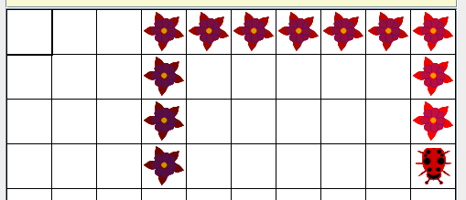
Bug
ActorWorld world = new ActorWorld();
Bug dude = new Bug();
world.add(new Location(3,3), dude);
world.show();
© A+ Computer Science - www.apluscompsci.com
Notes:
In this example, a default Bug is created.
A default bug is red and facing NORTH.
The bug moves NORTH until it reaches the top of the grid. The bug them turns in 45 degree increments until it finds an empty location to which to move.

Slide 27
open
bugone.java
© A+ Computer Science - www.apluscompsci.com

Slide 28
Critter
© A+ Computer Science - www.apluscompsci.com

Slide 29
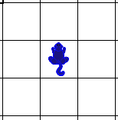
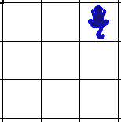
Critter
Critter differs from actor in that a critter moves around the grid and eats specific types of other actors.
Critter randomly picks one of its valid adjacent empty locations and moves to that location.
© A+ Computer Science - www.apluscompsci.com
Notes:
Critter is a suped up actor that moves around the grid and eats other actors.
Critter will eat all neighbors that are not critters and not rocks.
Critter randomly selects one of its valid empty adjacent locations. Critter moves to the new location.

Slide 30
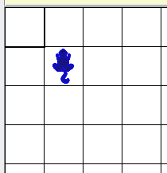
Critter
ActorWorld world = new ActorWorld();
Critter thang = new Critter();
Location loc = new Location(1,1);
world.add(loc, thang);
world.show();
© A+ Computer Science - www.apluscompsci.com
Notes:
//shortcut version of the code above
ActorWorld world = new ActorWorld();
world.add(new Location(1,1), new Critter());
world.show();

Slide 31
open
critterone.java
© A+ Computer Science - www.apluscompsci.com

Slide 32
imports
© A+ Computer Science - www.apluscompsci.com

Slide 33
imports
Imports are used to tell Java
where to find a class.
import info.gridworld.grid.Location;
import info.gridworld.actor.Rock;
import info.gridworld.actor.Flower;
import java.awt.Color;
© A+ Computer Science - www.apluscompsci.com

Slide 34
open
gridworldtwo.java
© A+ Computer Science - www.apluscompsci.com

Slide 35
Start work
on ActorBox
© A+ Computer Science - www.apluscompsci.com

